Slide 1
Test Link – Presentation Basic Flow

Slide 2
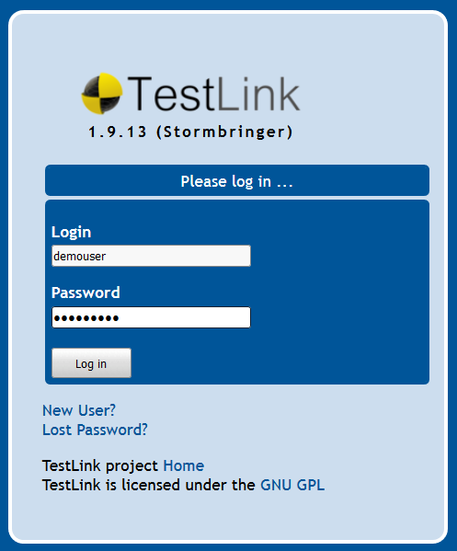
Login
Following are the steps to “Login”.
1. Access URL of Test Link.
2. Enter Login ID and Password.
3. Click on “Login” button
User will be “Login” successfully and
Dashboard will be displayed as per the
Access Roles and Rights.

Slide 3
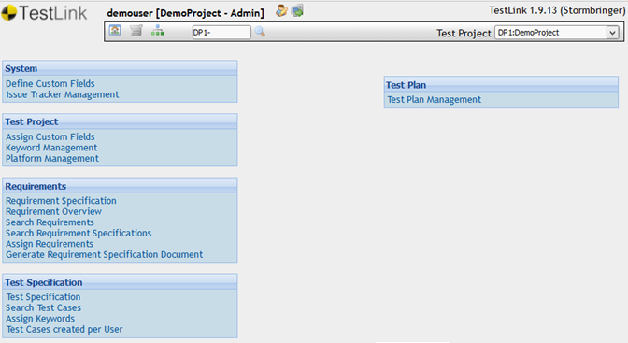
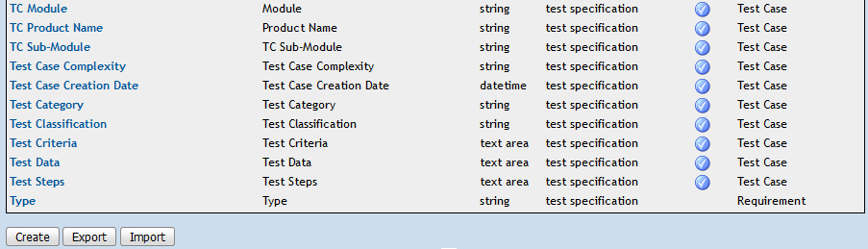
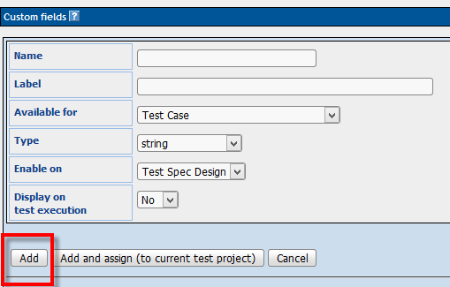
Define Custom Fields
1
Following are the steps to “Define Custom
Fields”.
1. Click on “Define Custom Fields” under
System Tab from User Dashboard.
2. Click on “Create” button to add new
Customer Field.
Enter the data of the Custom Field
which needs to be created in test link for
The selected project.
3. Click on “Add” button
Custom Field will be added Successfully.
2
3

Slide 4
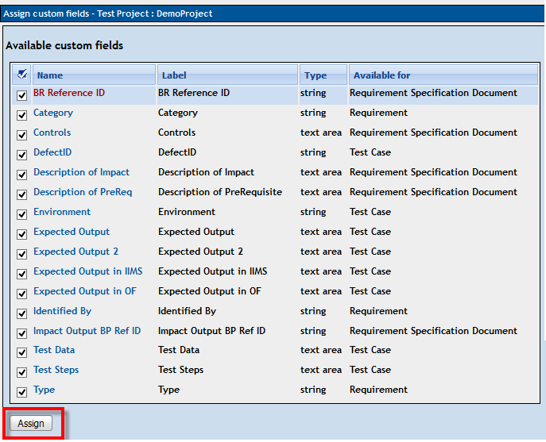
Assign Custom Fields
Following are the steps to “Assign Custom
Fields” to the Project.
1. Click on “Assign Custom Fields” under
System Tab from User Dashboard.
Select the Custom Field which needs to
Be assigned for the project.
2. Click on “Assign” button
Custom Field will be assigned
Successfully.
1
2

Slide 5
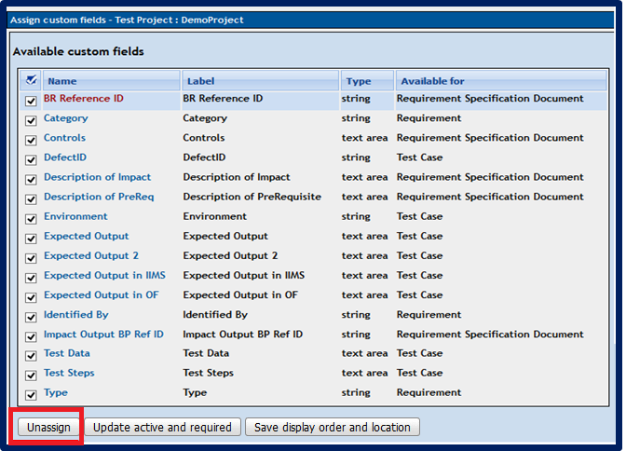
Unassign Custom Fields
Following are the steps to “Unassign Custom
Fields” to the Project.
1. Click on “Assign Custom Fields” under
System Tab from User Dashboard.
Select the Custom Field which needs to
Be unassigned for the project.
2. Click on “Unassign” button
Custom Field will be unassigned
Successfully.
1
2

Slide 6
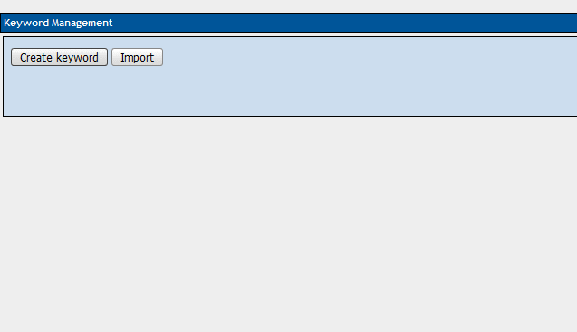
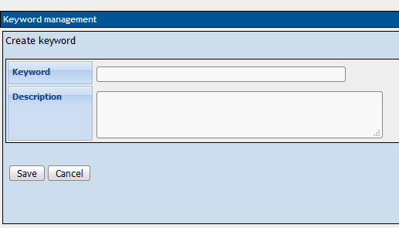
Keyword
Management
Following are the steps for “Keyword
Management” to the Project.
1. Click on “Keyword Management” under
System Tab from User Dashboard.
2. Click on “Create Keyword”.
Enter the details.
3. Click on “Save” button
Keyword will be Created Successfully.
1
2
3

Slide 7
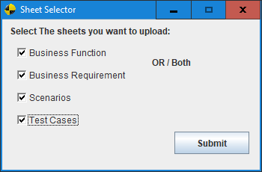
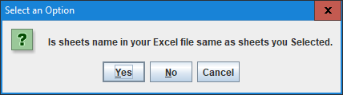
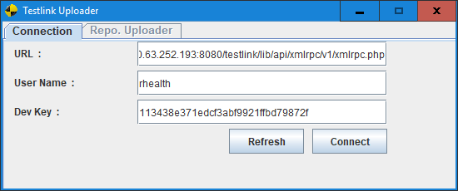
Uploading
Test Suite
1
Following are the steps for uploading
“Test Suite” to the Project.
Click on “Test Link Uploader.exe” file.
2. Select the Worksheets to be uploaded in
Testlink and click on “Submit” button.
3. Select “Yes” from Select an Option popup.
4. Enter “TestLink app URL” in TestLink uploader
as provided in TestLink Connectivity file.
5. Enter “User Name” in TestLink uploader as
provided in TestLink Connectivity file.
6. Enter “Dev Key” as provided in TestLink
Connectivity file.
7. Click on “Connect” Button for Procced further
With the selection of test suite for upload.
2
3
4
5
6
7

Slide 8
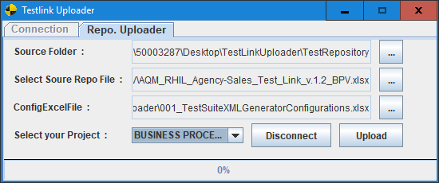
Uploading
Test Suite (Contd.)
8. Select Repository Folder from TestLink Uploader
Directory (Test suite Location).
9. Select the Source Repository File (Test Suite)
Test Cases will be uploaded.
10. Select Configuration File from TestLink Uploader
Folder.
11. Select Project for which Test Suite needs to be
Uploaded.
12. Click on “Upload” button to proceed further
With uploading the Test Suite.
Business Function, Business Process and
Business Scenarios will be uploaded
Successfully along with proper Traceability.
1
2
3
2
3
4
5

Slide 9
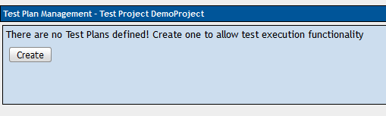
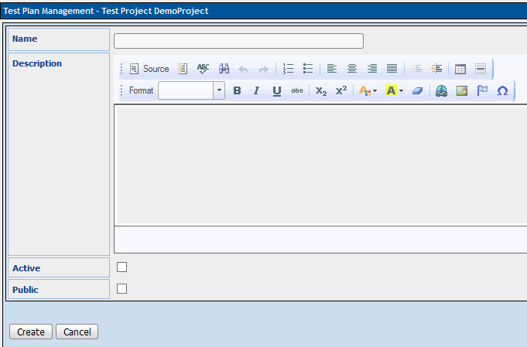
Test Plan
Management
1
Following are the steps for creating
“Test Plan” to the Project.
1. Click on “Test Plan Management”
Under Test Plan Tab from User Dashboard.
2. “Click on “Create” button
Enter the data of the Test Plan
which needs to be created in test link for
The selected project
3. Click on “Create” button.
The mentioned Test Plan will be added
Successfully and will be displayed on
Dashboard
2
3

Slide 10
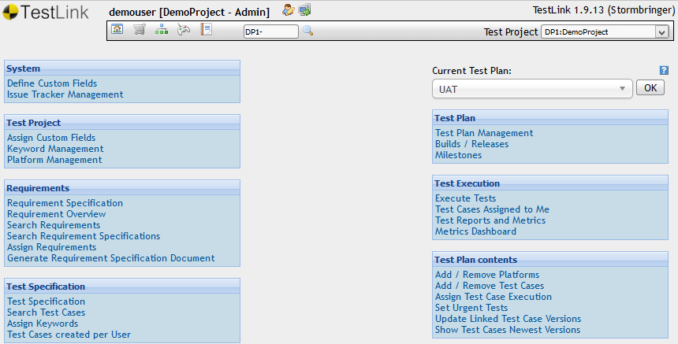
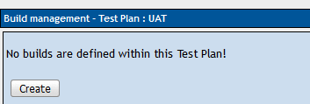
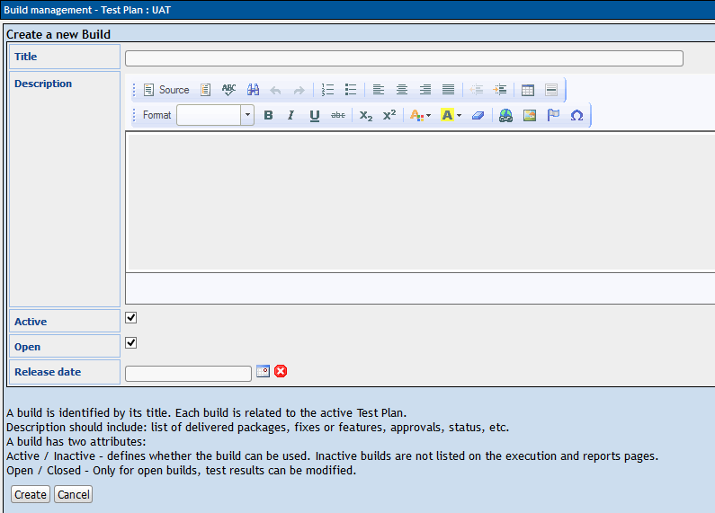
Build/Release
Management
Following are the steps for creating
“Build/Release” to the Project.
1. Click on “Build/Release”
Under Test Plan Tab from User Dashboard.
2. “Click on “Create” button
Enter the data of the Build/Release
which needs to be created in test link for
The selected project
3. Click on “Create” button.
The mentioned Build/Release will be
added Successfully and will be mapped
To the test plan.
1
2
3

Slide 11
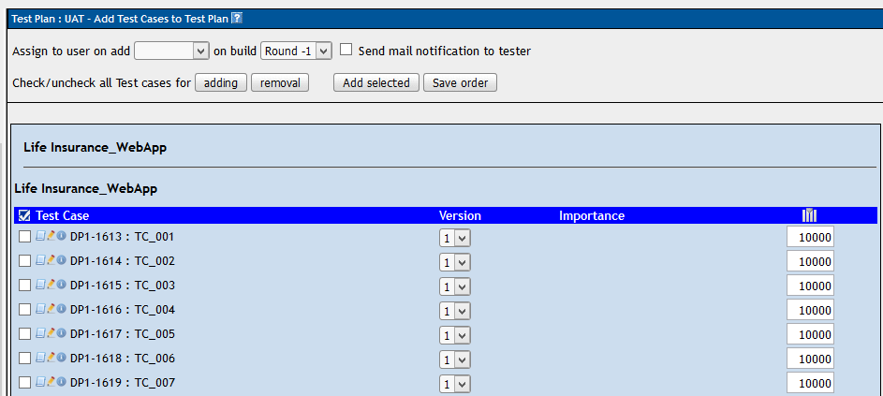
Add/Remove
Test Cases
2
Following are the steps to
“Add/Remove” test cases to the
Test Plan.
1. Click on “Add/Remove Test Cases”
Under Test Plan Contents Tab from
User Dashboard.
Select “Assigned”, “Build”.
Select All or Specific Test Cases to
Add/Remove from Test Plan.
2. Click on “Add/Remove Selected”
button.
The selected test cases will be Added/
Removed from the mapped Test Plan
1

Slide 12
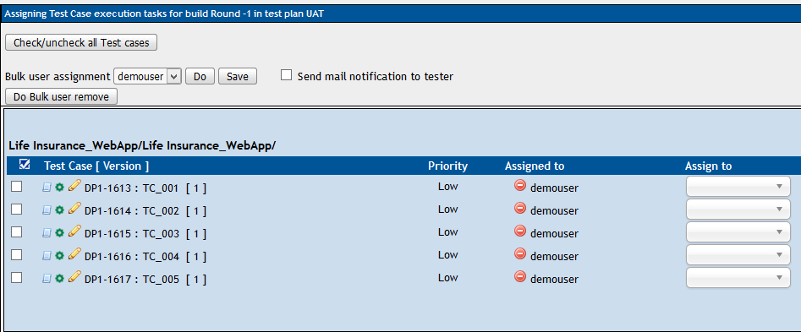
Assign
Test Cases
2
Following are the steps to
“Assign” test cases to the
Users.
1. Click on “Assign Test Case Execution”
Under Test Plan Contents Tab from
User Dashboard.
2. Select “User” from the drop-down.
Click on “DO” button.
Click on “Save” button.
The selected test cases will be Assigned
To the Selected User.
1

Slide 13
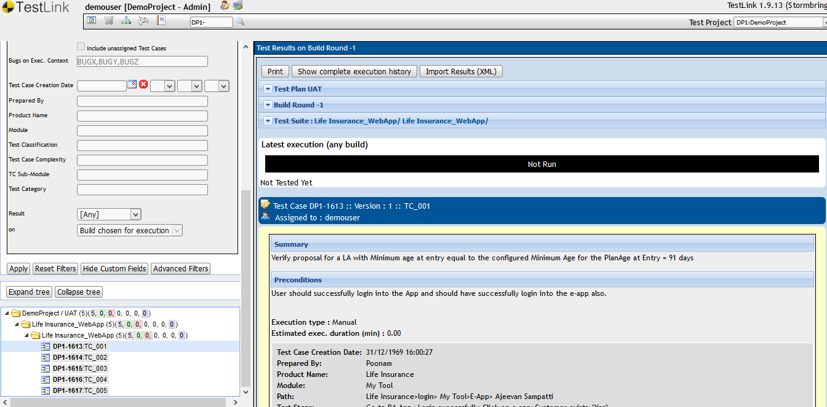
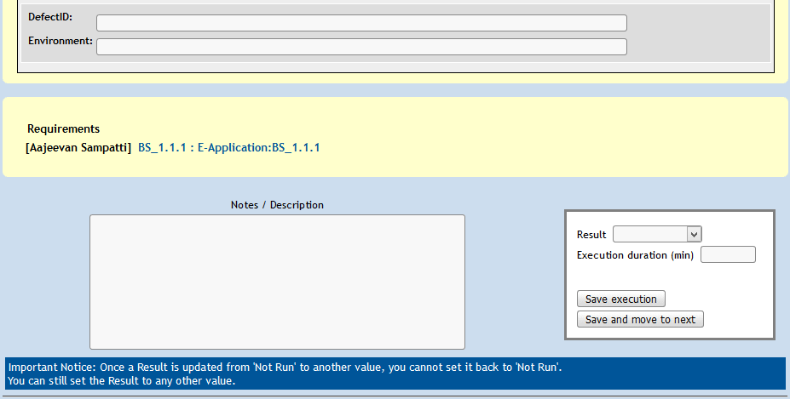
Execute
Test Cases
Following are the steps to
“Execute” test cases by users.
1. Click on “Execute Tests” Under Test
Execution Tab from User Dashboard.
2. Expand the Test Case Hierarchy from
Left frame as referred in screenshot.
Select the Specific Test Cases which
Needs to be executed.
Enter “Defect ID”
Enter “Notes/Description” as Actual
Output
3. Click on “Save Execution” button.
1
2
3

Slide 14
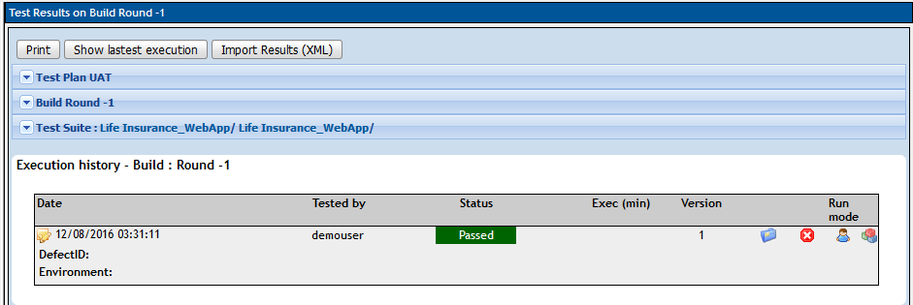
Execute
Test Cases (Contd)
7. After Clicking on “Save Execution”
Button the result will be displayed
As referred in the screenshot.
8. The number of time test case is
Executed is recorded in the execution
History which can be viewed from
Test Case Header area by clicking on
“Show Complete History”.
9. Evidence of the test execution can
Be recorded by clicking on the
“Attach files” and uploading it to the
Test case during execution.
10. Execution result can be soft deleted
By clicking on the “x” button.

Slide 15
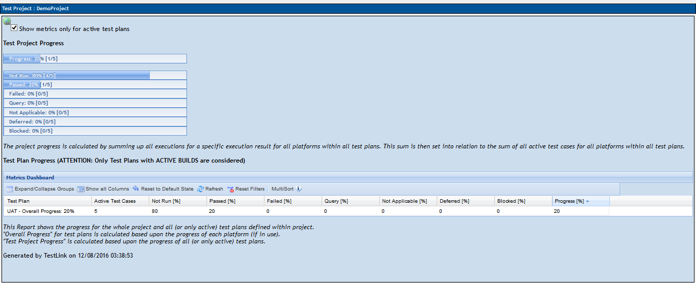
Metrics
Dashboard
Following are the steps to view
“Metrics” dashboard for Execution
Status.
1. Click on “Metrics Dashboard” Under
Test Execution Tab from User Dashboard.
2. The Metrics will be shown for the
Selected Project.
1

Slide 16
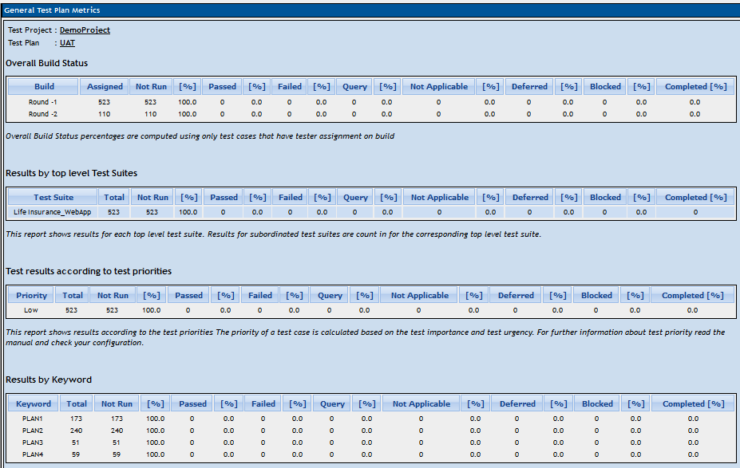
General Test Plan Metrics
Following are the steps to view
“General Test Plan Metrics” Report
for Execution Status.
1. Click on “Test Report and Metrics”
Under Test Execution Tab from User Dashboard.
2. Click on “General Test Plan Metrics”
3. This Report will display following Status:
Overall Build Status
Results by Top Level Test Suites
Test Results according to Priorities
Results by Keyword

Slide 17
Define Custom Fields
Following are the steps to “Logout”.
1. Access User Dashboard.
2. Click on “Logout” button
User will be “Logout” successfully and
Login will be displayed back.

Slide 18
THANK YOU…

